Slide 1

Project: Languru
SPRING 2023 - CS 691- CAPSTONE PROJECT
PROFESSOR HENRY WONG
PACE UNIVERSITY
Team 5 - RADIANT
Thanh Pham
Musa Nishat
Noel Sam Routhu
Indeevara Tadikonda
Hariharammurthy Krishnamoorthy

Slide 2
Agenda
The objective of this presentation is to show what we planned and took for the Sprint 2.
Improvement from previous deliverable.
Describe the Minimal Viable Product and our mock up design.
Acceptance Criteria and user stories.
Sprint 2 backlog and Test cases.
Retrospective Sprint 2.
Sprint 3 Schedule and Plans.
Product Demo and Screenshots.

Slide 3
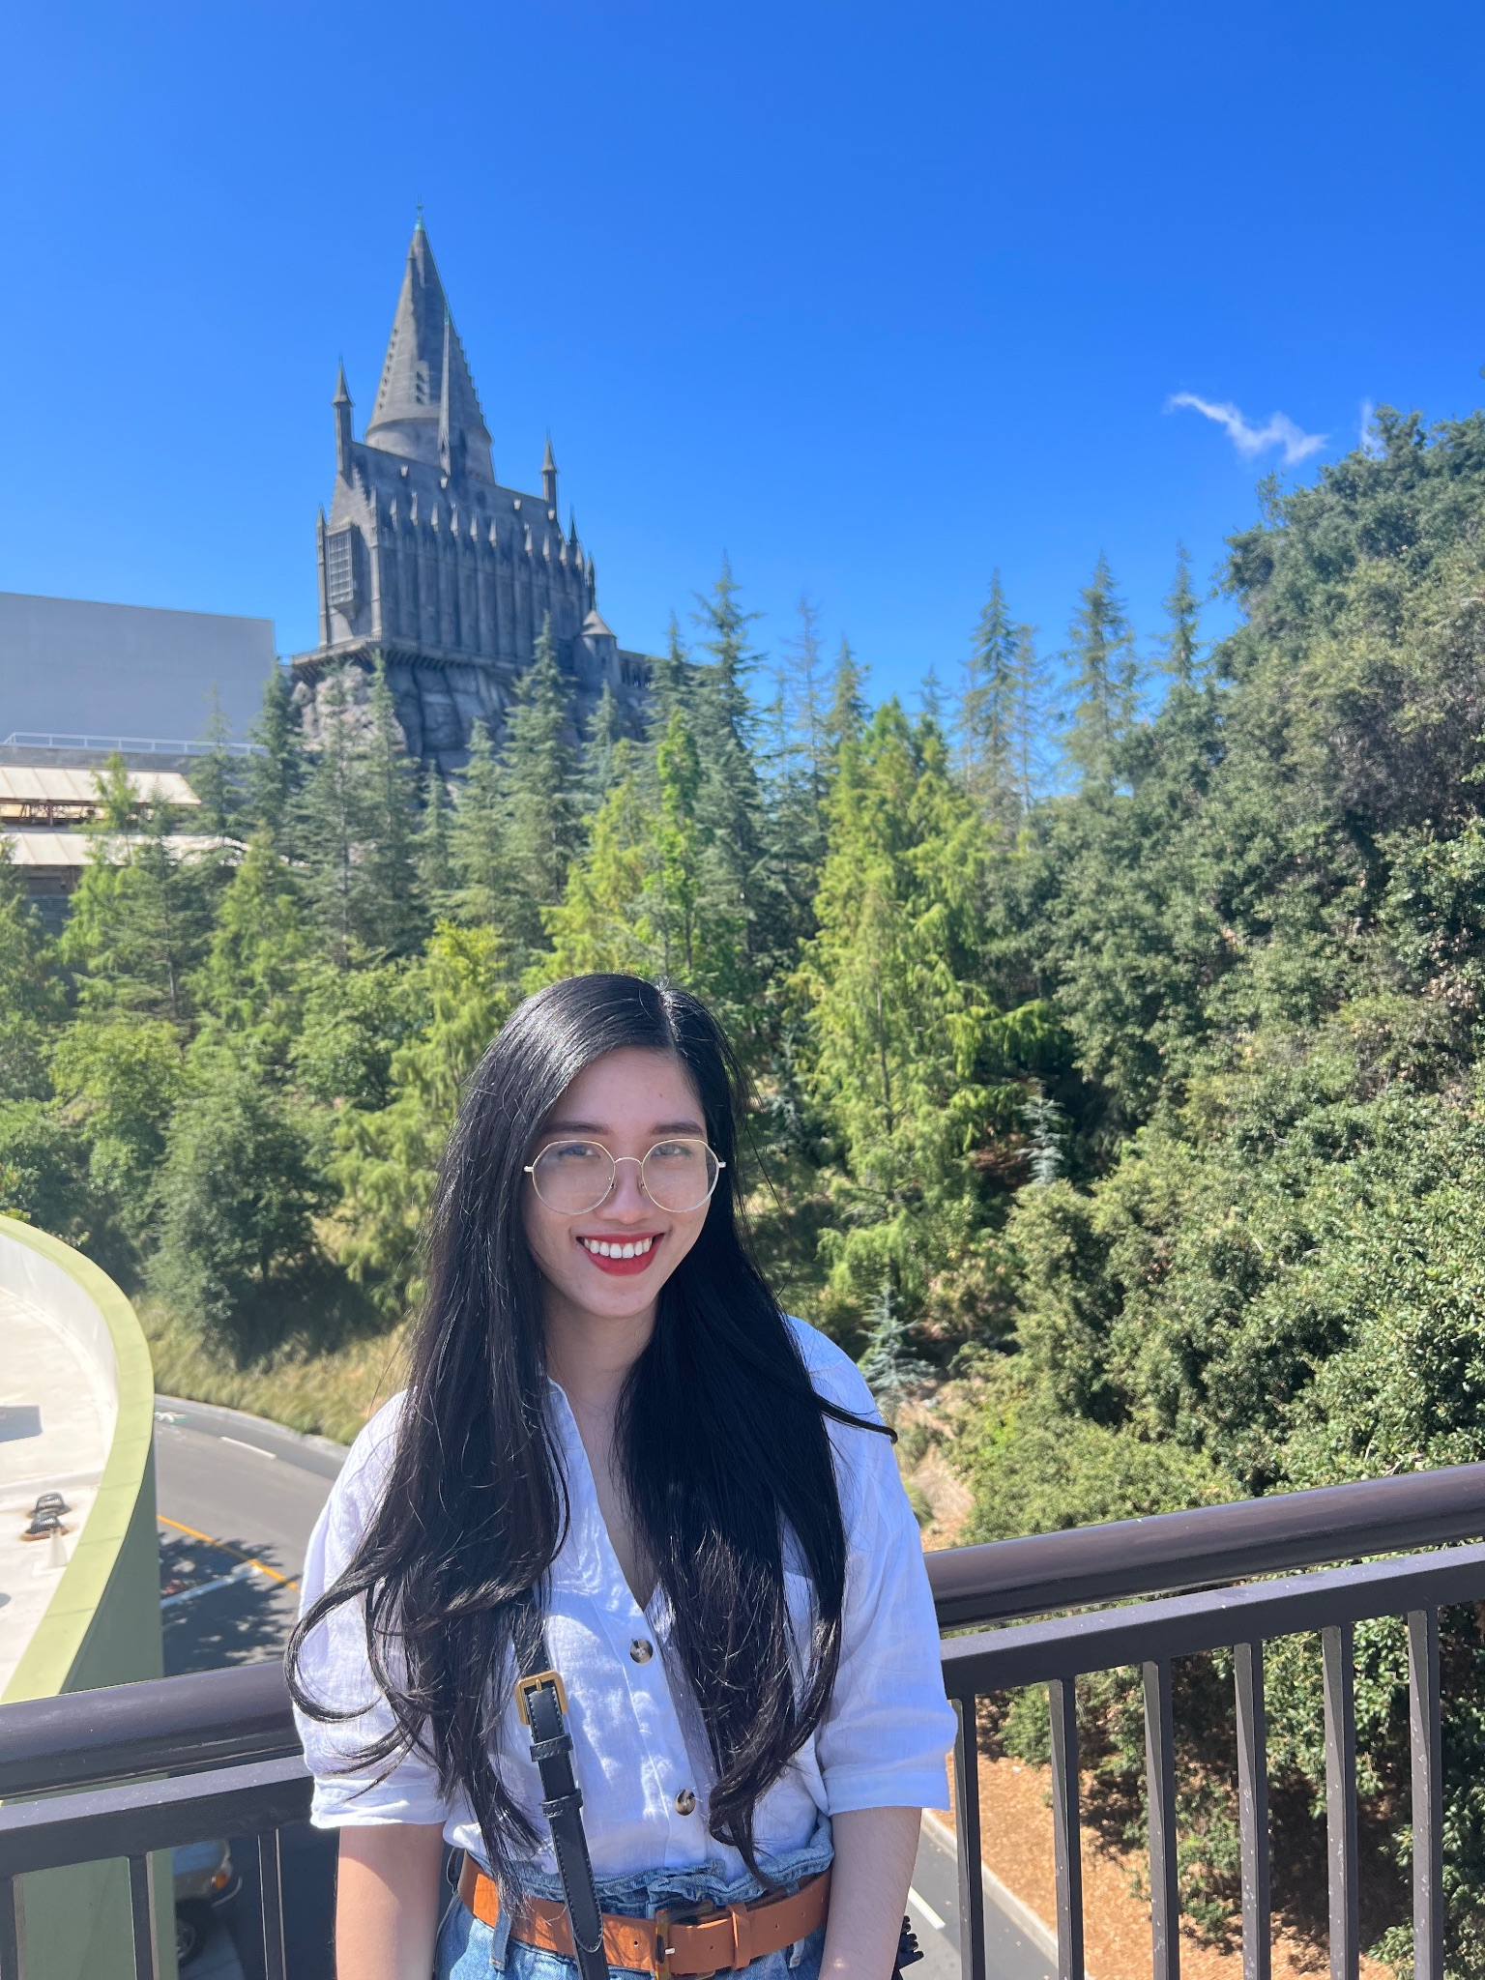
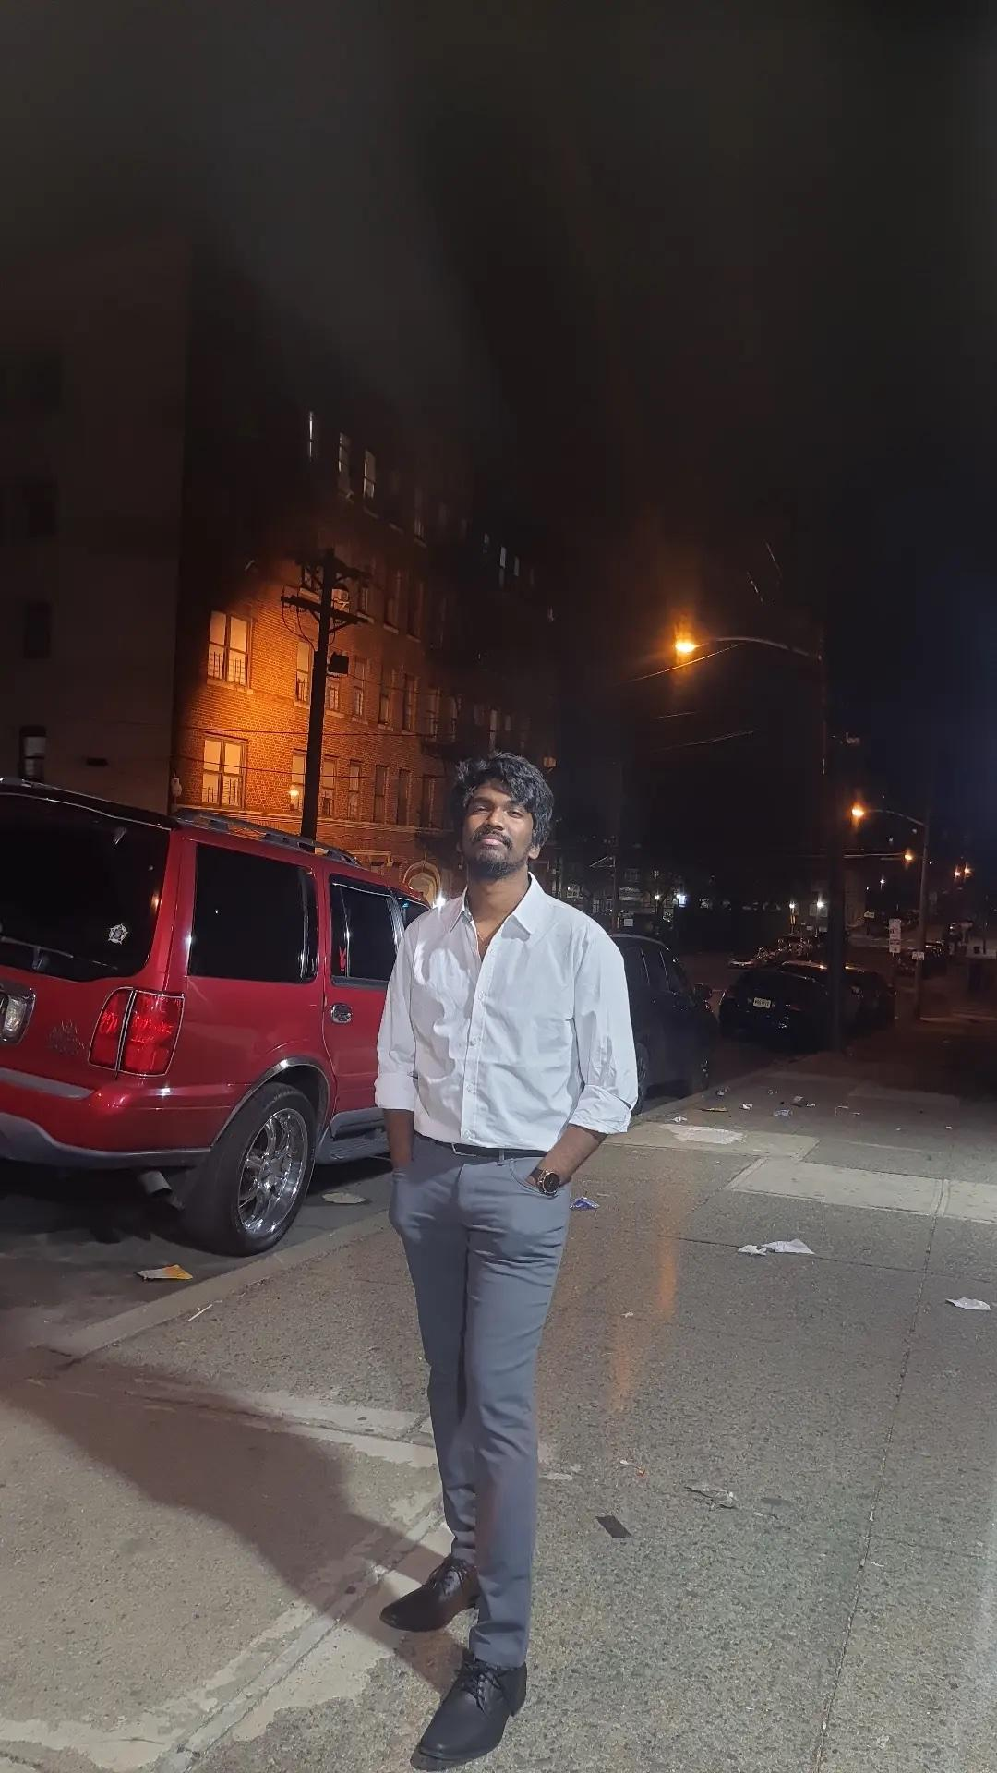
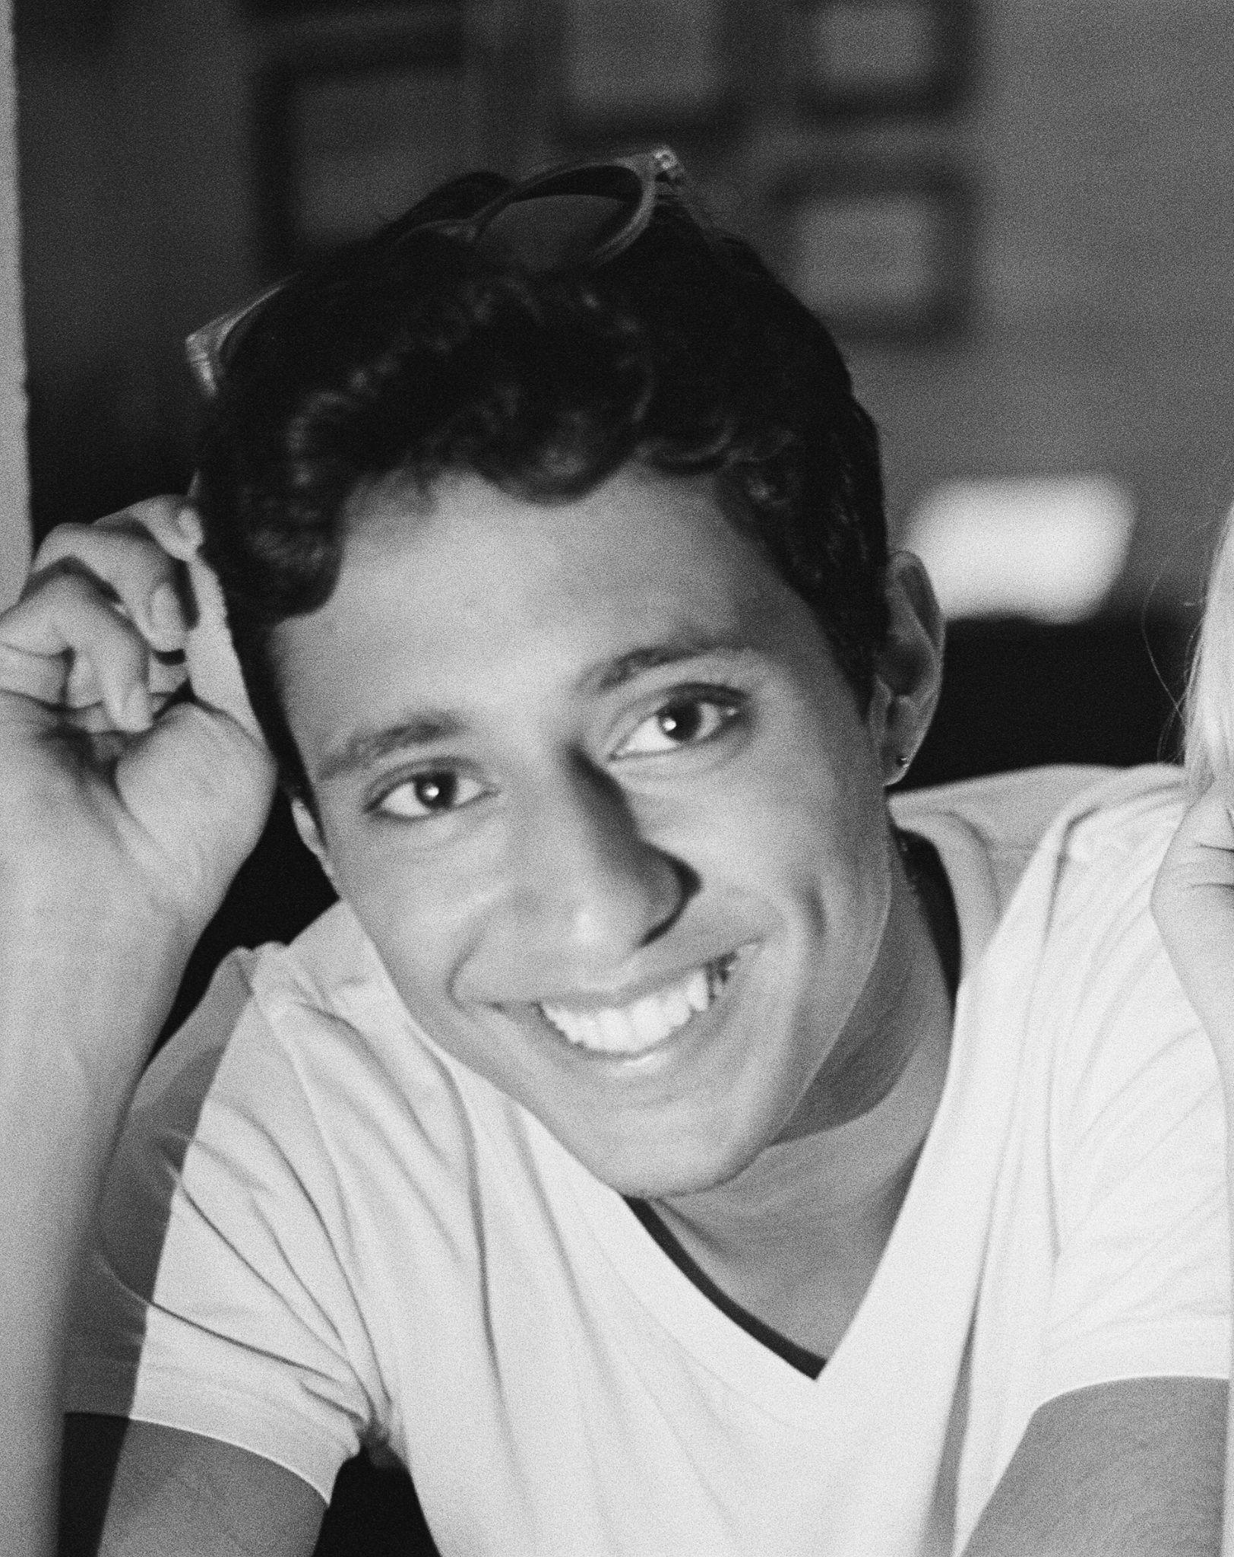
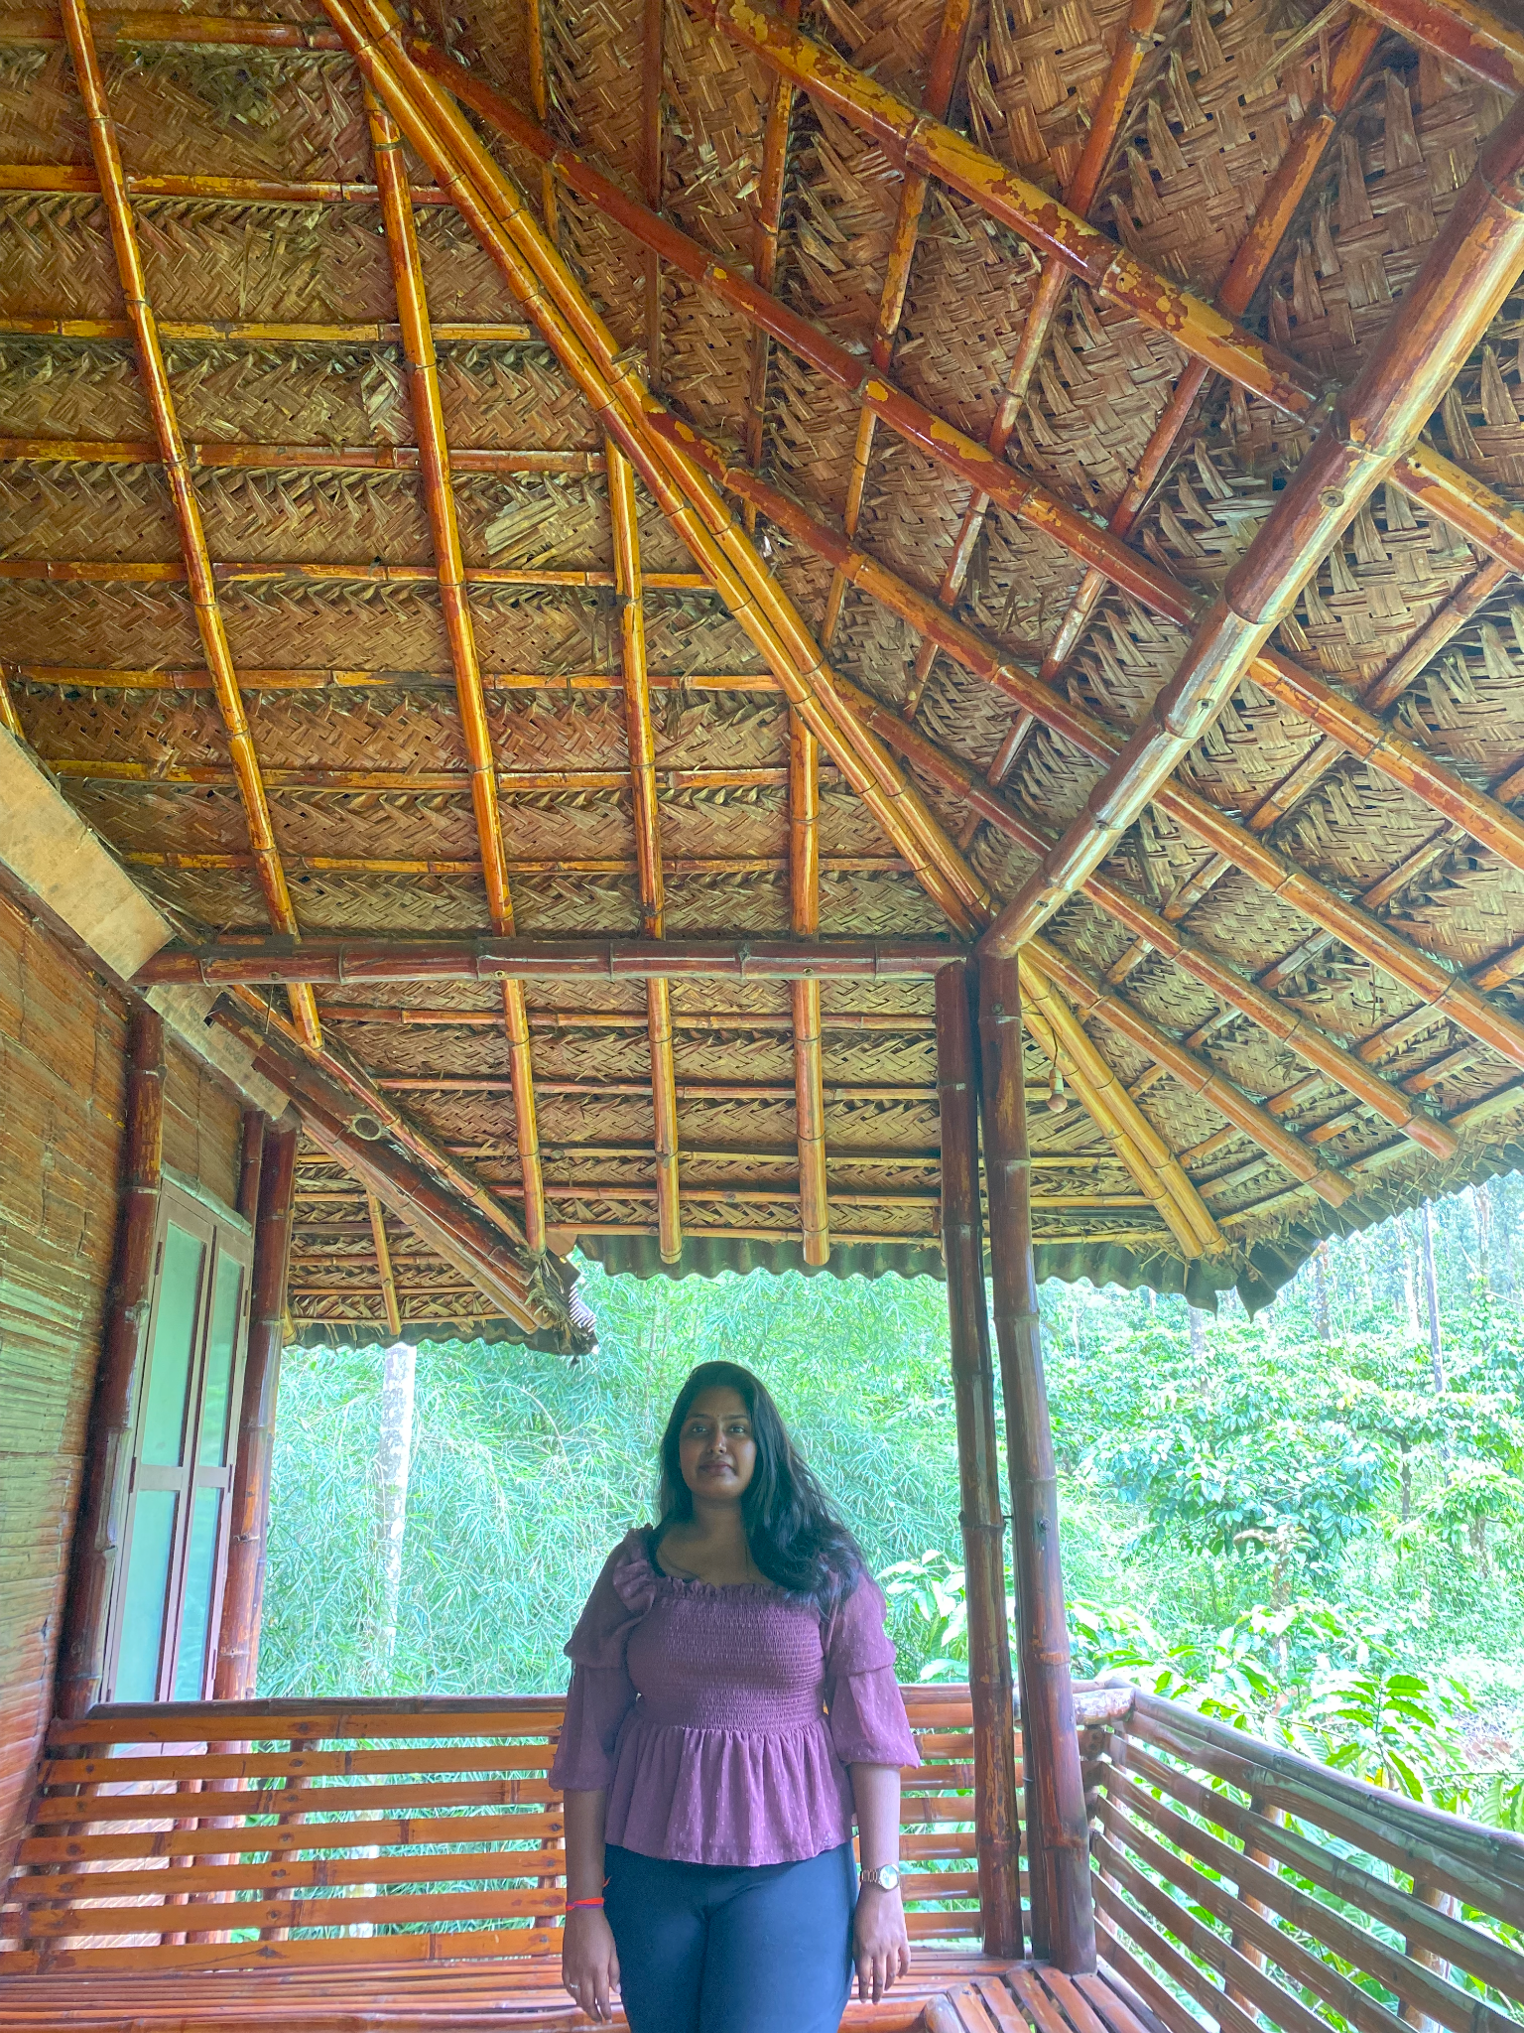
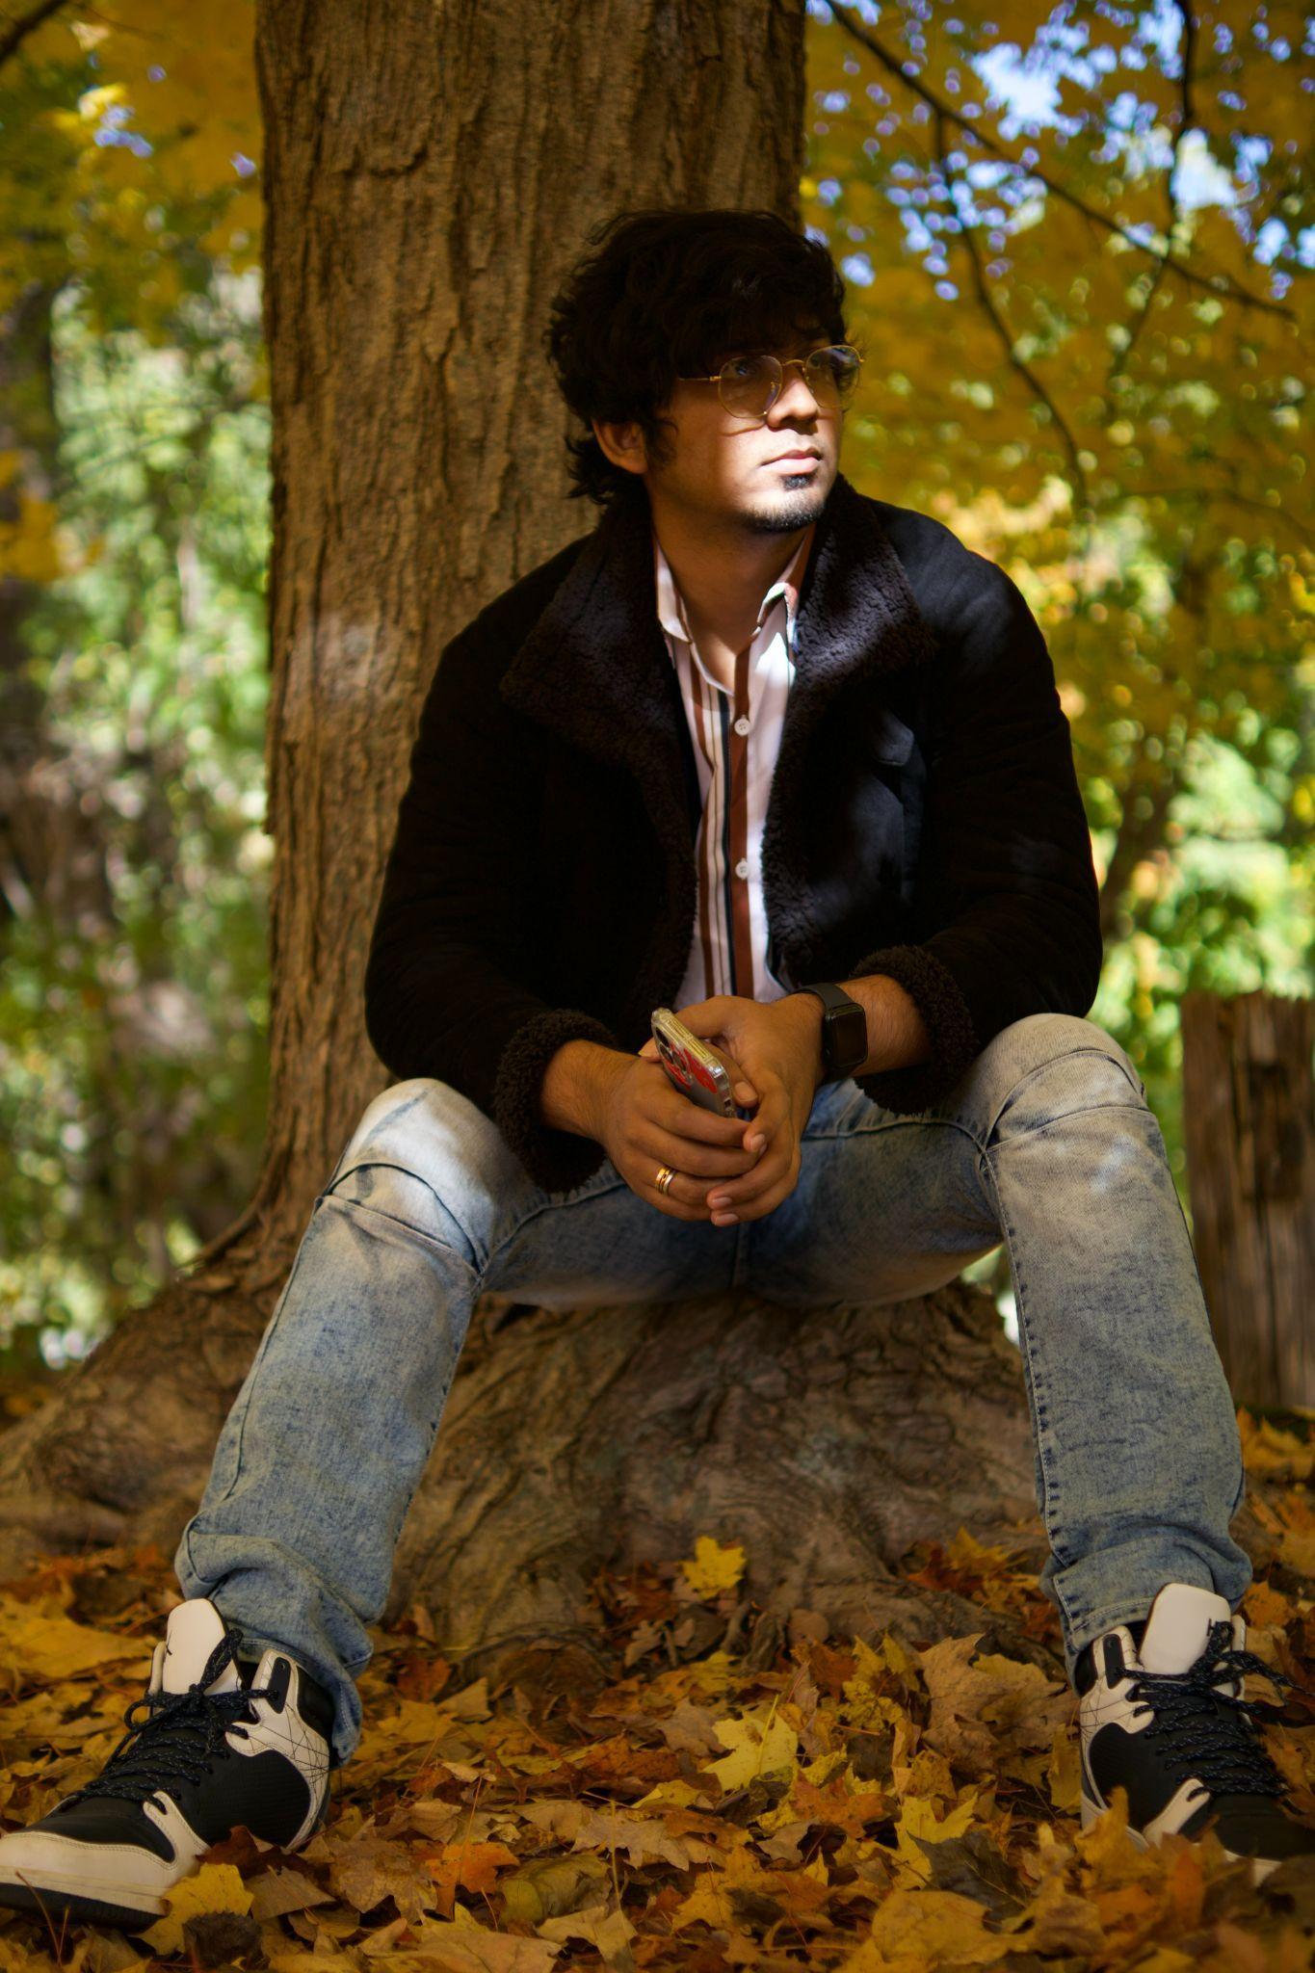
Team member roles
Thanh Pham
(Developer,
Scrum Master)
Noel Sam Routhu
(Database Administrator)
Musa Nishat
(Developer)
Indeevara Tadikonda
(Developer)
Hariharammurthy Krishnamoorthy
(Quality Analyst And Tester)

Slide 4
Improvement + Change
1. Project’s schedule was added in this sprint.
4. In the retrospective slides, we added actions in the next steps for future sprint.
2. We ran our meetings using Agile's standup methodology, which greatly improved efficiency
5. Radiant team decided to build a mobile application instead of creating a web application.
3. We added a statement above whenever adding bullet points your the presentation slide.

Slide 5
Problem Statement
English learners faces challenges when they speak E.L correctly due to limited feedback on their speech while English teachers’ feedback is costly and time consuming.
The current speech recognition technology is not accurate enough to provide reliable feedback on pronunciation, which can hinder the learning process.

Slide 6
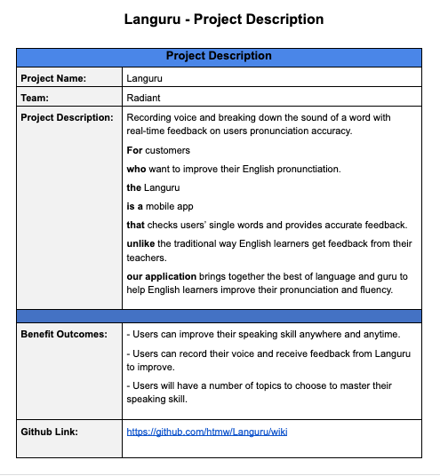
Project Description

Slide 7
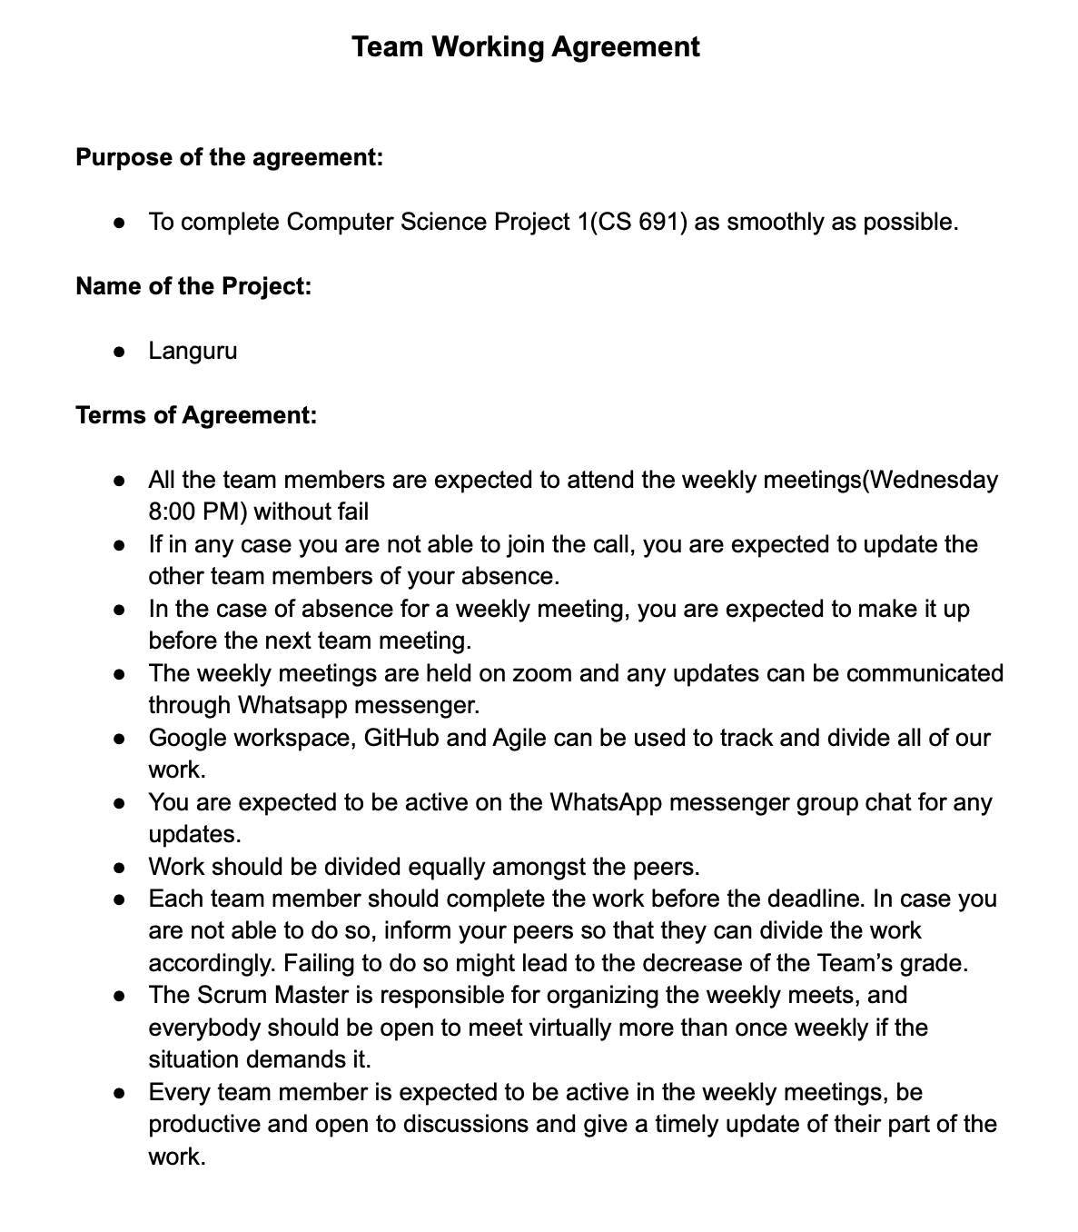
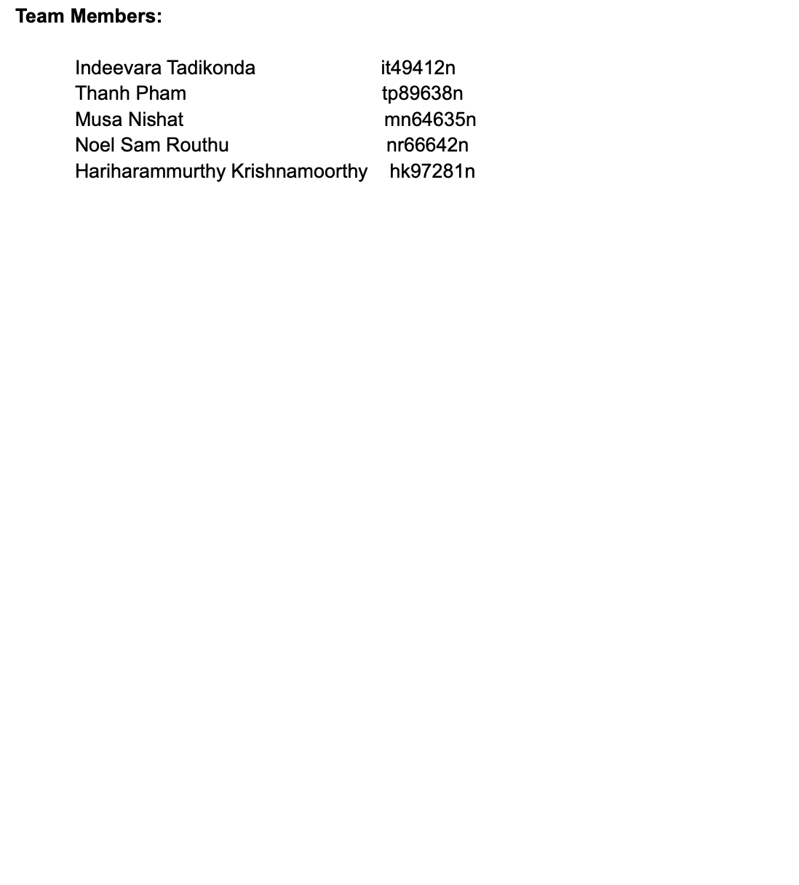
Team Working Agreement

Slide 8
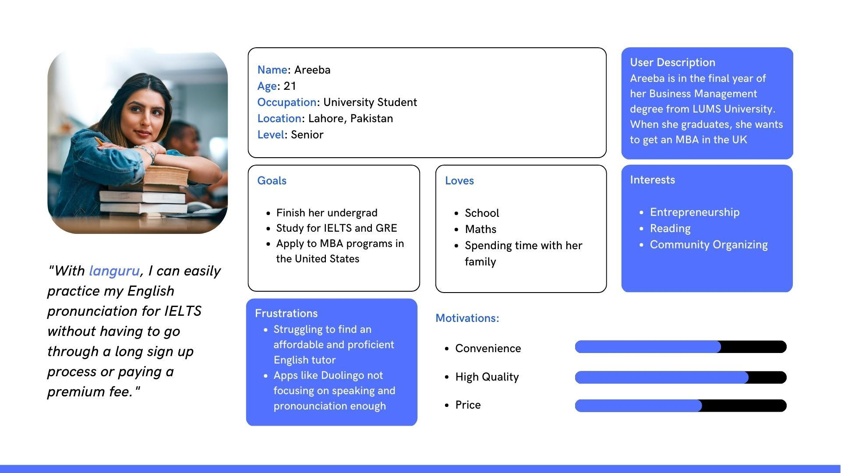
Personas

Slide 9
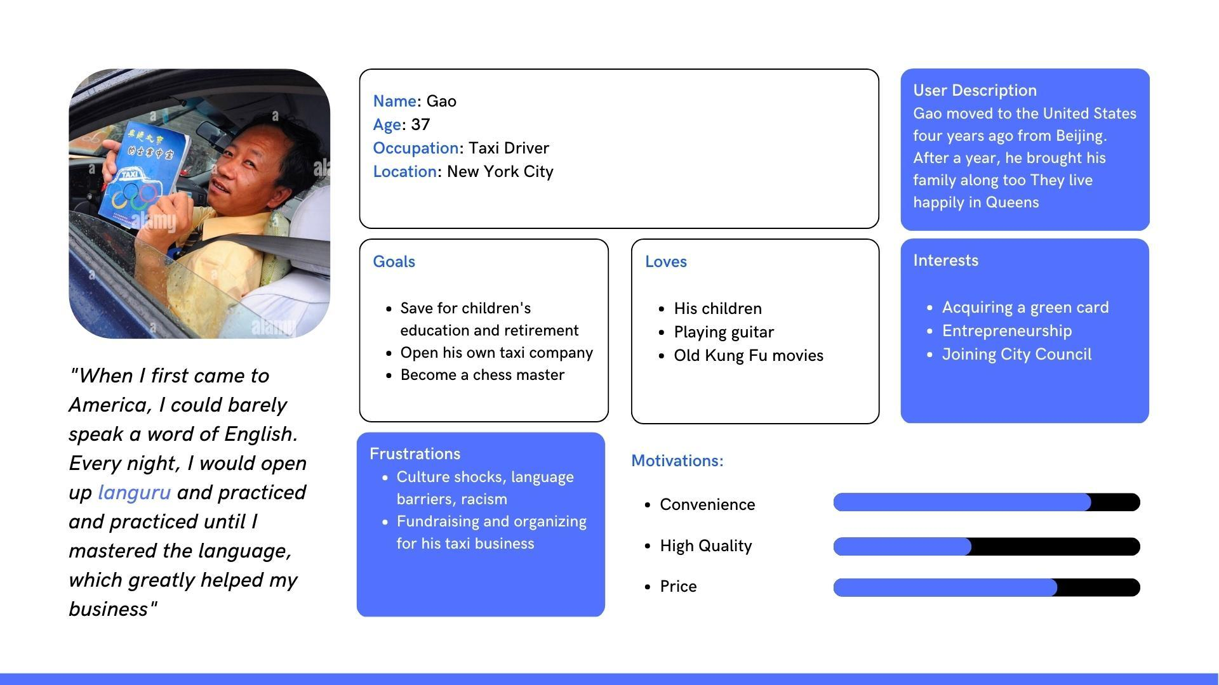
Personas

Slide 10
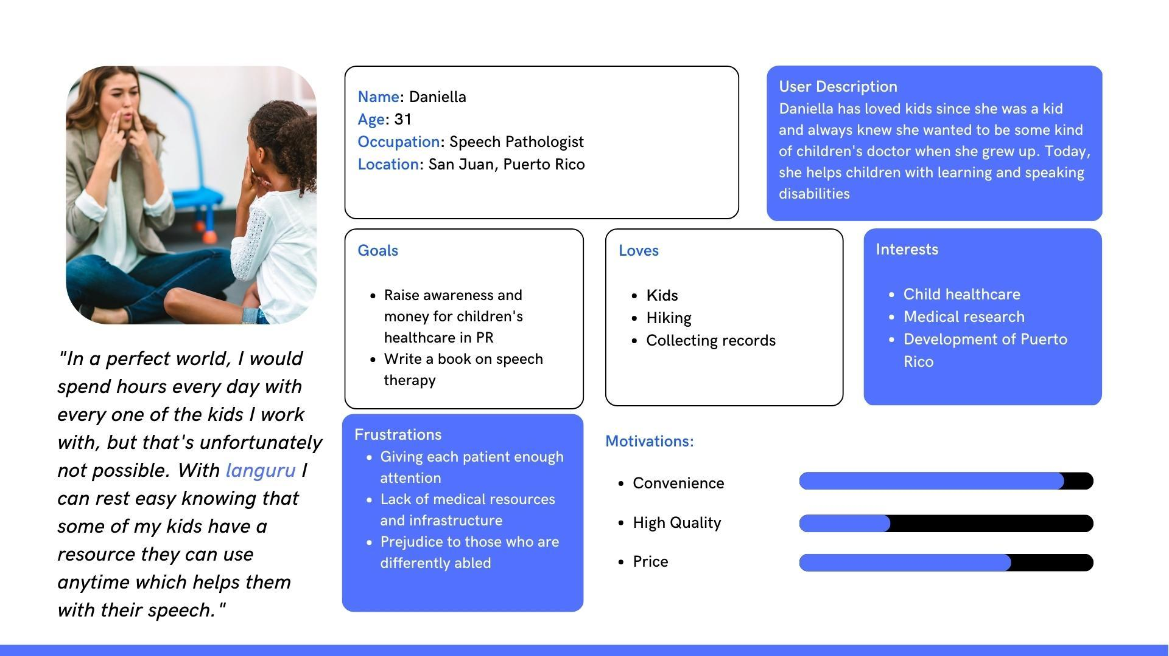
Personas

Slide 11
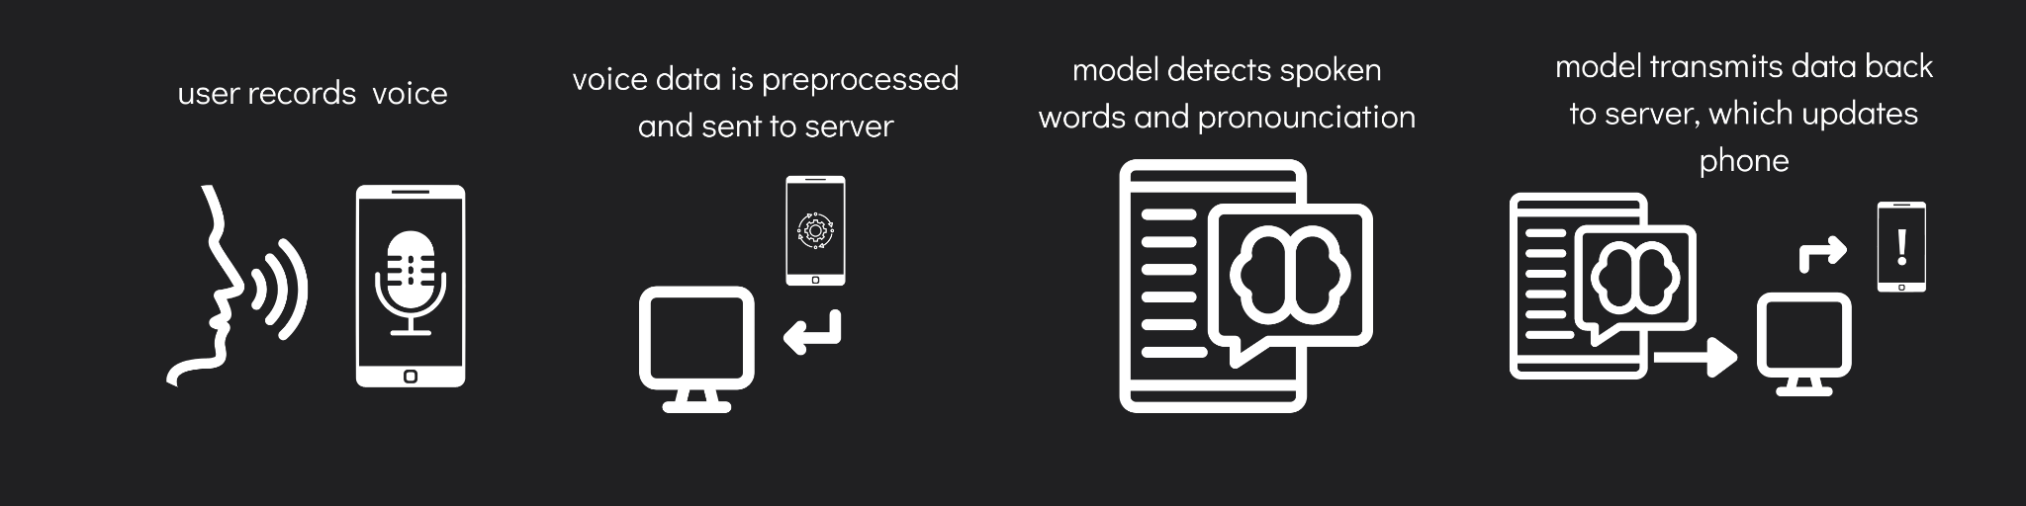
MINIMAL VIABLE PRODUCT (MVP)
Mobile application with speech recording capability
Machine learning algorithm/API to break down individual spoken words, detect, and note incorrect pronunciations
Server with functionality to receive voice data and send back analyzed data
Server to host machine learning model
Steps:

Slide 12

Product Demo

Slide 13
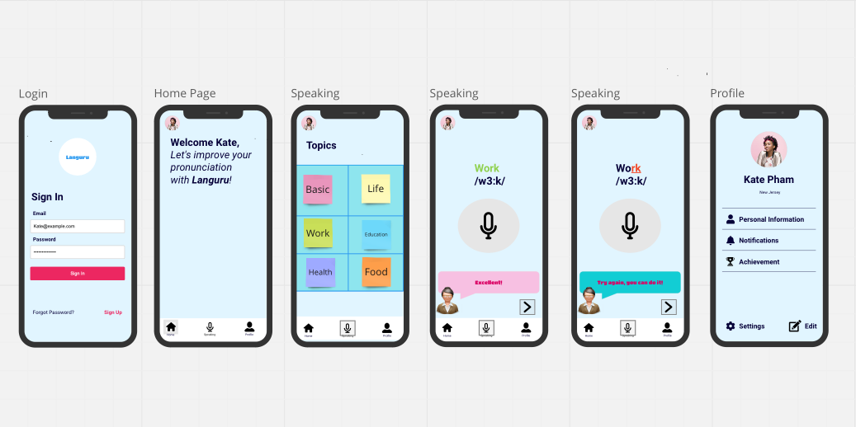
MOCK UP DESIGN

Slide 14
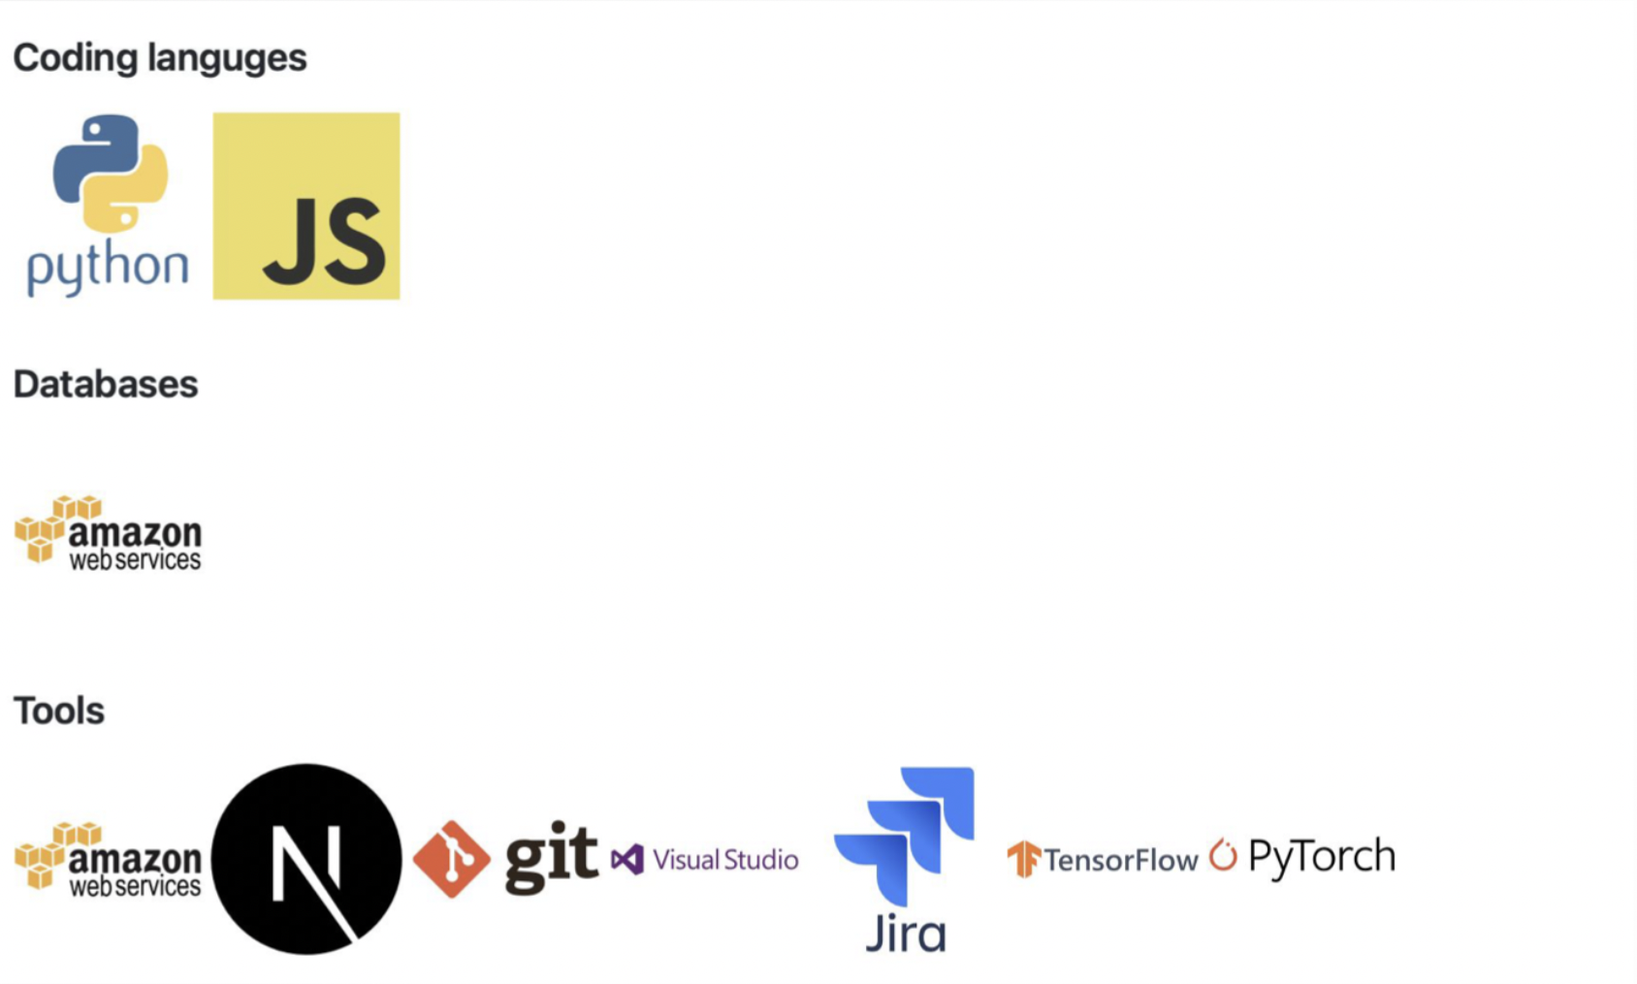
Technologies

Slide 15
Diagrams

Slide 16
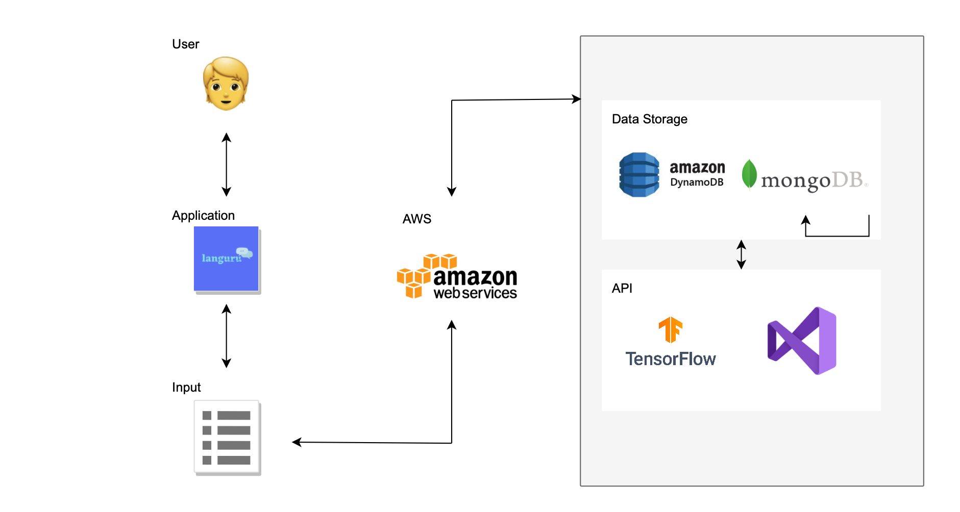
Conceptual Architecture Diagram

Slide 17
Sequence Diagram
User
Languru
Speech Recognition
Record Audio
Process Audio data
Analyze Speech Data
Return Feedback
Review Feedback

Slide 18
User Stories
As a | I want to | so that | Feature
English language learner | Receive real-time feedback on my pronunciation accuracy | I can improve my speaking skills and sound more fluent | Pronunciation Feedback
English language learner | Practice speaking English using different words and phrases | I can expand my vocabulary and improve my pronunciation skills | Vocabulary Practice
English language learner | Receive personalized recommendations for pronunciation practice based on my weaknesses | I can focus on improving areas where I need the most help | Personalized Recommendations
English language learner | Receive feedback on my intonation and stress patterns | I can sound more natural and fluent when speaking English | Intonation and Stress Feedback
English language learner | Track my progress and see improvement over time | I can stay motivated and feel a sense of accomplishment | Progress Tracking

Slide 19
User Stories
As a | I want to | so that | Feature
English language learner | Practice my pronunciation in different contexts, such as in a business setting or social setting | I can prepare for real-life situations where I need to speak English | Contextual Practice
English language learner | Have access to a variety of English accents to practice with | I can become familiar with different accents and improve my listening and speaking skills | Accent Diversity
English language learner | Receive feedback on my grammar and syntax when speaking English | I can improve my overall communication skills | Grammar and Syntax Feedback
English language learner | Record my voice and receive real-time feedback on my pronunciation accuracy | I can improve my English speaking skills more efficiently and effectively | Voice Recognition
English language learner | Have access to a large database of English words and phrases | I can practice my pronunciation and fluency across a wide range of topics | Database

Slide 20
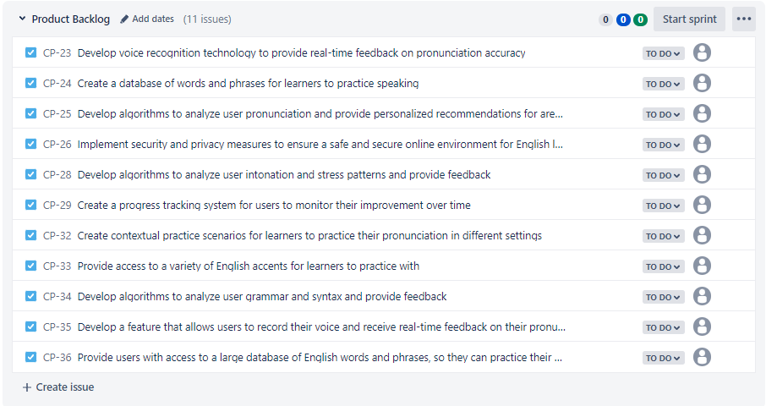
Product Backlog

Slide 21
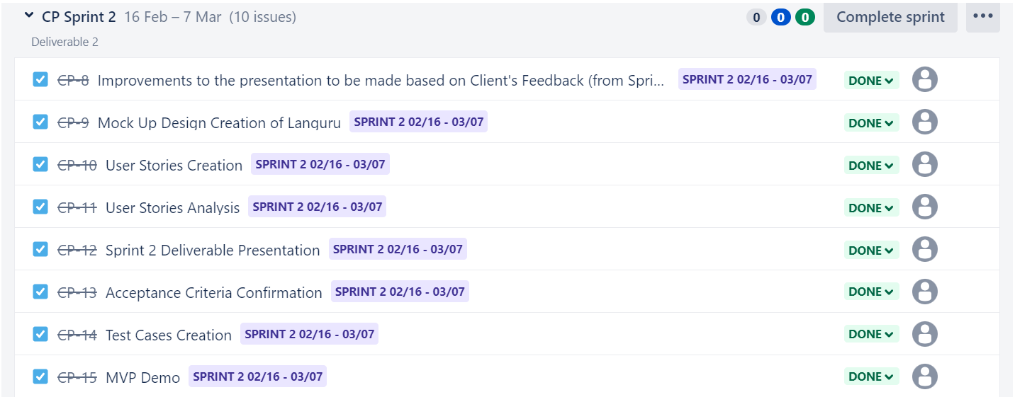
Sprint 2 Backlog

Slide 22
Sprint 2 Backlog

Slide 23
Test cases
&
Acceptance Criteria

Slide 24
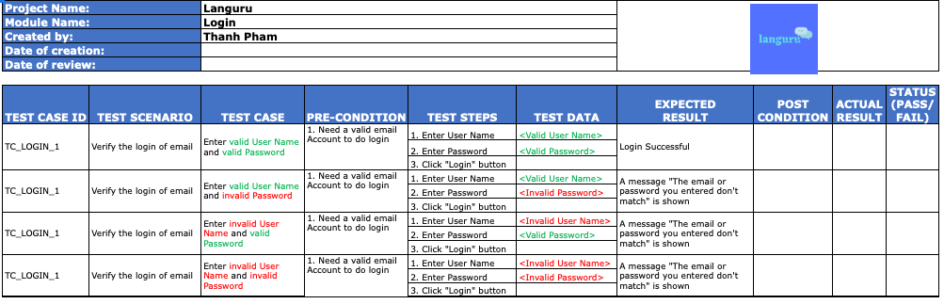
Test Case (Login)

Slide 25
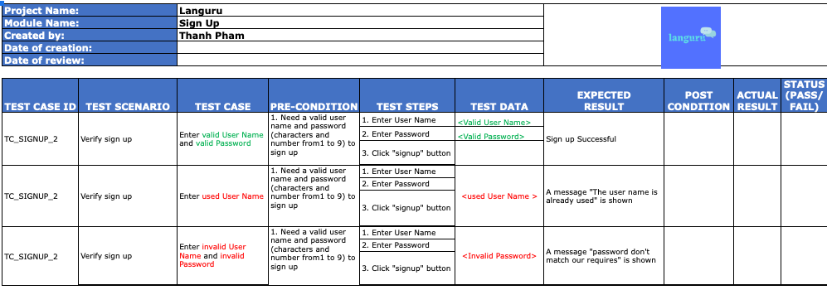
Test Case (Sign Up)

Slide 26
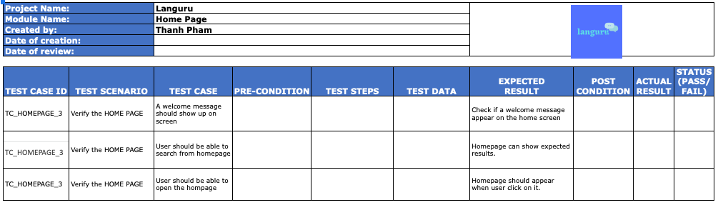
Test Case (Home page)

Slide 27
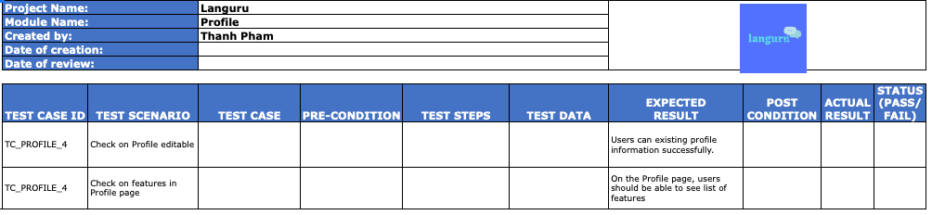
Test Case (Profile)

Slide 28
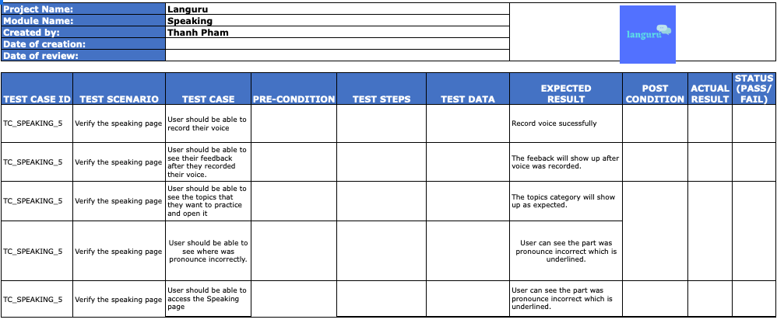
Test Case (Speaking)

Slide 29
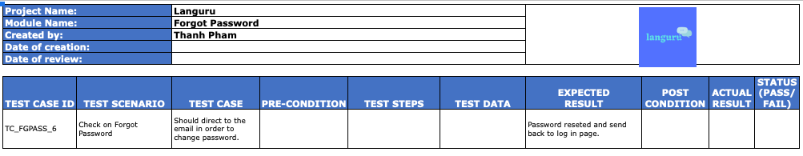
Test Case (Forgot Password)

Slide 30
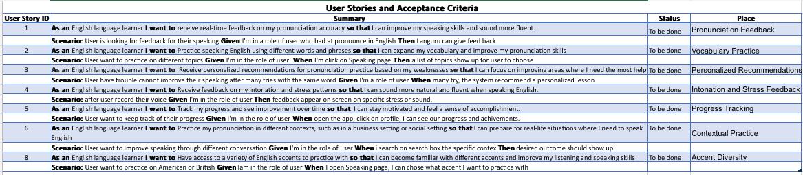
Acceptance Criteria

Slide 31
Retrospective
What went well
What hold us back
We did a good job on dividing work for each team member equally.
Our team can help other members in the group when they have difficulty understanding and completing their work.
Time management
Understanding our assigned topics and reaching out for help
Expectations for the sprint were unclear
Uncoordinated vision over the app and its functionality

Slide 32
Retrospective
Actions for the next Sprint
Improve Documentation
Discuss expectations, deadlines, and definitions of done more clearly
Leave plenty of time before deadlines to fix problems
Further discuss and align vision of app and its functionality

Slide 33
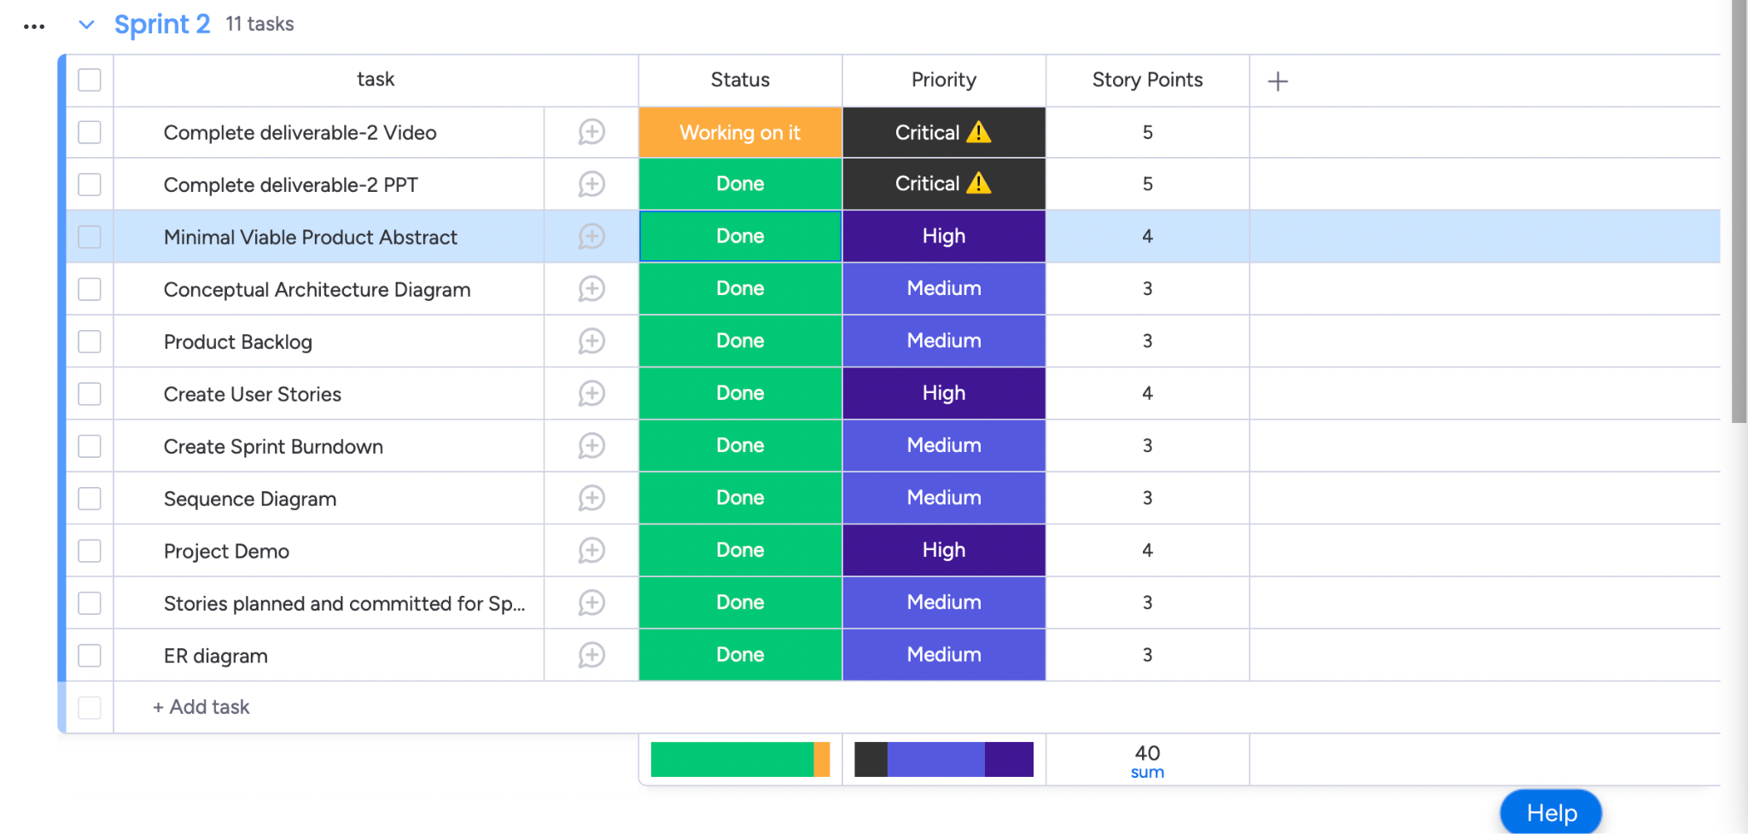
Sprint 2 Burndown

Slide 34
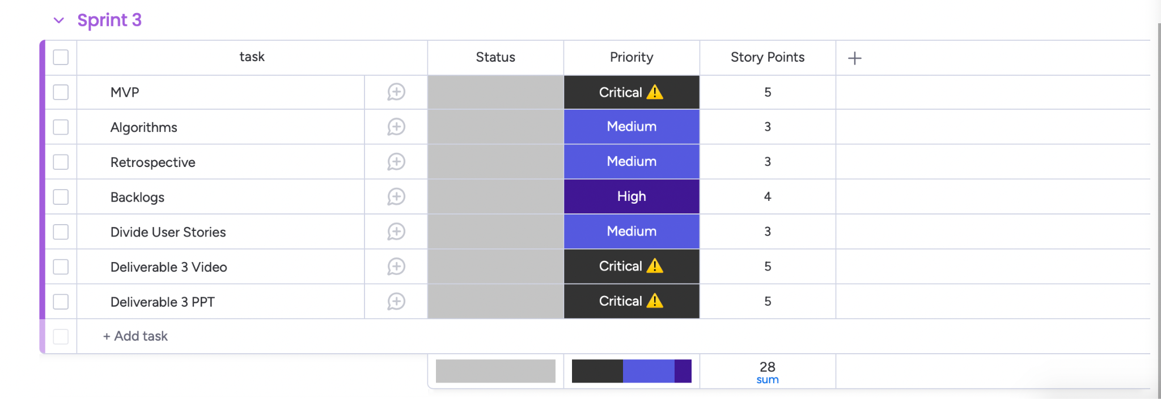
Sprint 3 Burndown

Slide 35
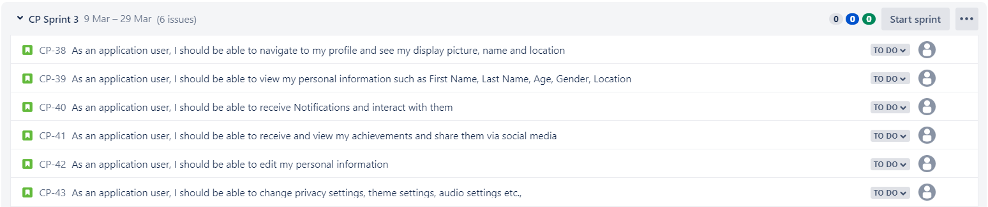
Sprint 3 (Stories Planned)

Slide 36
Current Demo (Sprint 2)

Slide 37
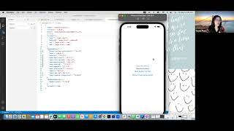
Current Demo (Sprint 2)

Slide 38
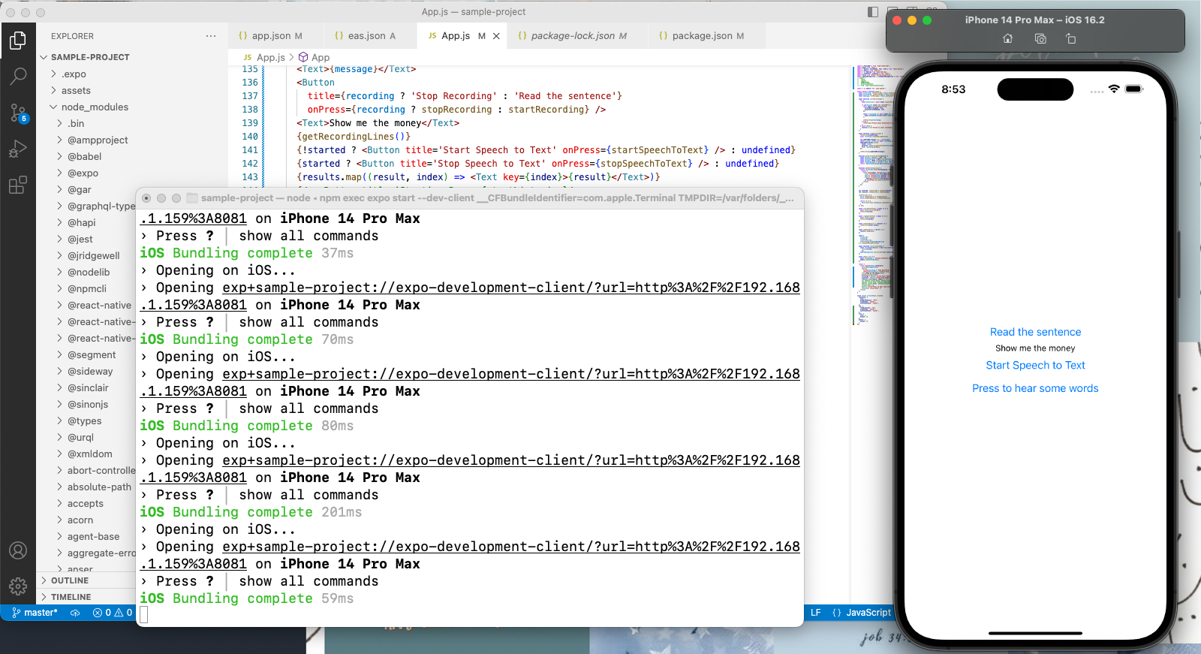
App Demo at Sprint 2

Slide 39
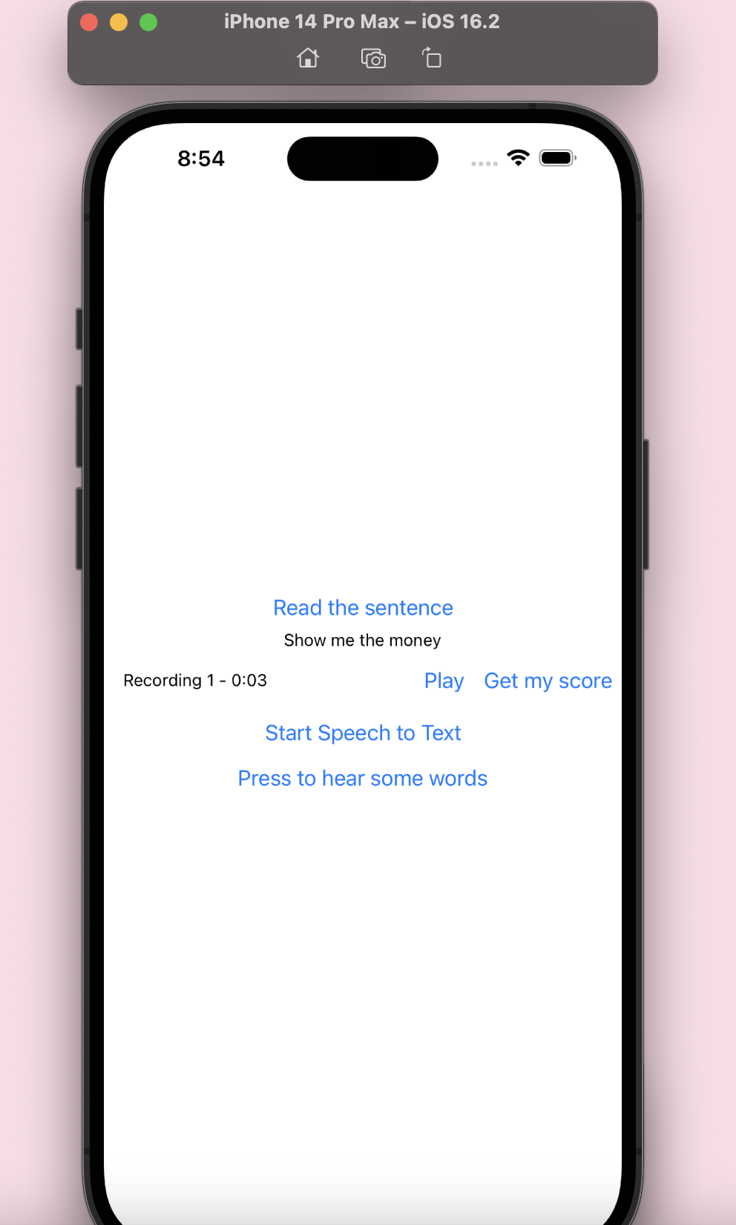
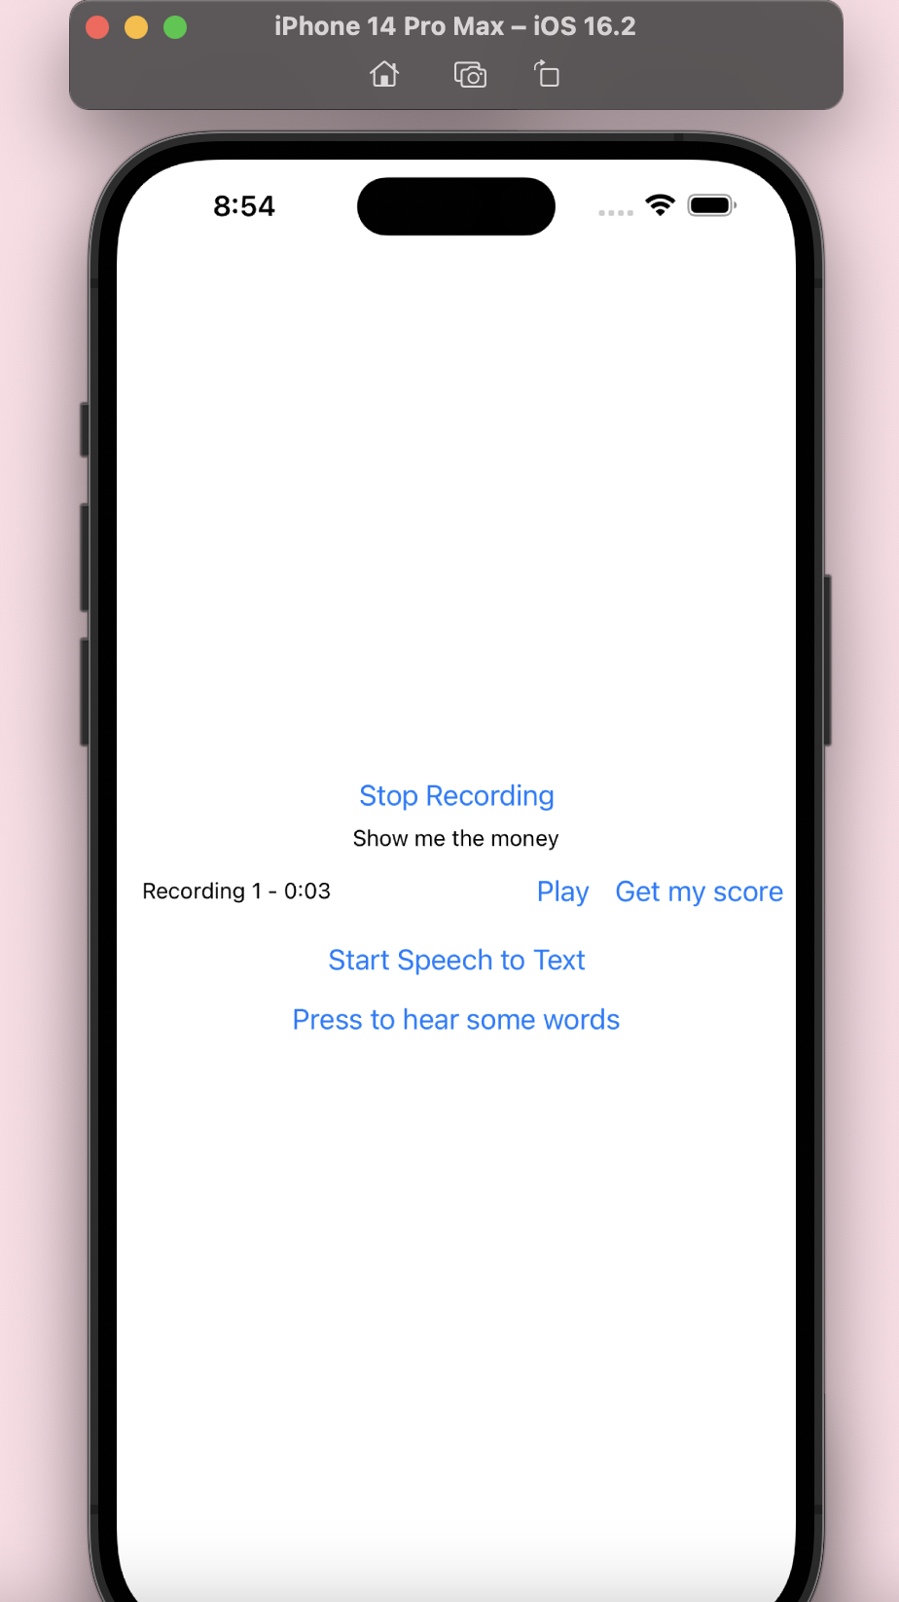
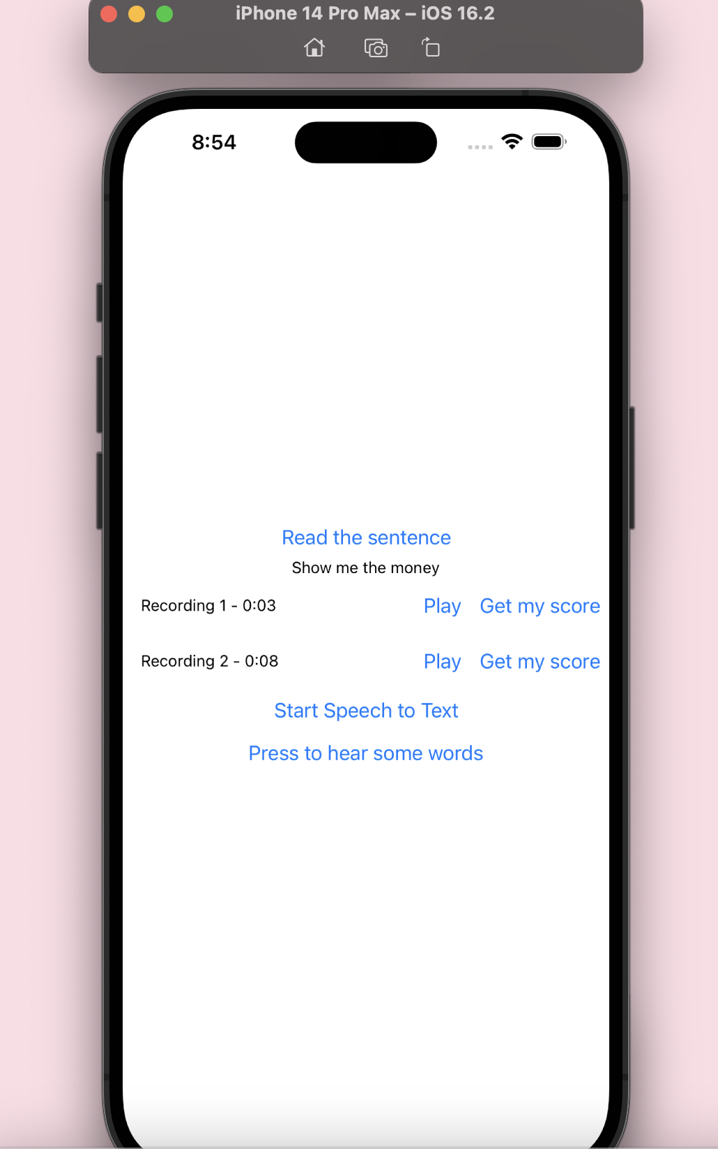
App Demo at Sprint 2

Slide 40
Github Link
https://github.com/htmw/Languru/wiki

Slide 41
Thank you for watching!

